Slide 1
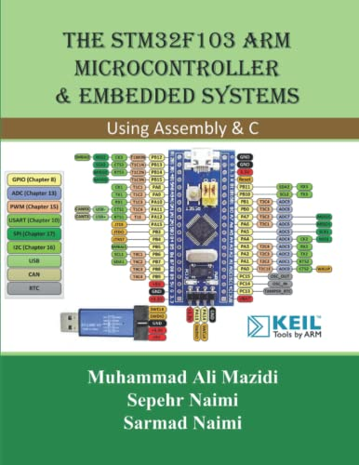

Lecture # 01M: Introduction to Microcontroller
Course Teacher: Prof. Dr. Engr. Muhibul Haque Bhuyan
Professor, Department of EEE
American International University-Bangladesh (AIUB)
Dhaka, Bangladesh

Slide 2
Outline
Differences between microcontroller and microprocessor
Differences between Harvard and Von Neumann Architectures
Introducing STM32 Microcontroller Board
Embedded Systems and IoT
Architecture of a Modern Microcontroller

Slide 3
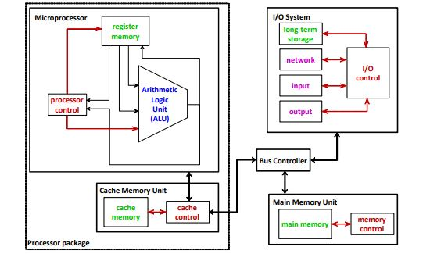
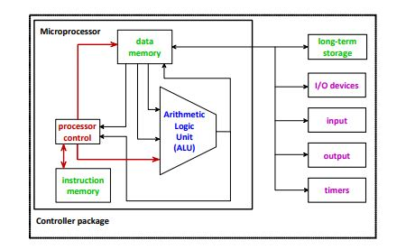
Some important Differences
Microprocessor Microcontroller

Slide 4
Comparison of Microprocessor and Microcontroller
Microprocessor
The integrated single-chip CPU of a computer system.
Controls the memory and I/O through a series of connections called busses.
CPU/Microprocessor:
Performs arithmetic or logic operations
Temporarily stores data and instructions in internal high-speed registers
Microcontroller
Single-chip microcomputers with limited capabilities.
Microprocessor, memory, and I/O – all fabricated in the same chip.
On-chip timers, A/D, and D/A converters.
Appropriate for dedicated applications.

Slide 5
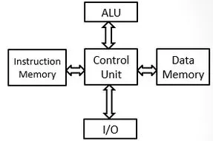
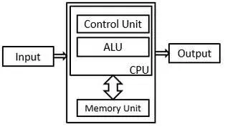
Architectures: Harvard vs. Von Neumann
Point of Comparison | Harvard Architecture | Von Neumann Architecture
Arrangement | Memory is divided into two memories: - Data memory - Instruction memory Term originated from Harvard Mark I relay based computer system | All memory is capable of storing all program elements, data and instructions. Also referred to as Princeton Architecture Based on the “First Draft of a Report on the EDVAC” by John Von Neumann published in 1945
System diagrams

Slide 6
Architectures: Harvard vs. Von Neumann
Point of Comparison | Harvard Architecture | Von Neumann Architecture
Addressing mode | Distinct program and data address spaces E.g. Instruction address zero is not the same as data address zero | Same memory is capable of storing both data and instructions Effectively no distinction between instructions and data
Speed of execution | Separate pathways for data and instruction memories Capable of executing instructions in a single clock cycle Data and instructions do not contend for a single memory pathway Faster even without cache memories | Shared pathway for data and instruction memories Requires at least 2 clock cycles to execute an instruction Suffers from “Von Neumann Bottleneck” – the limited data transfer rate between CPU and memory Introduction of cache memories can mitigate the bottleneck

Slide 7
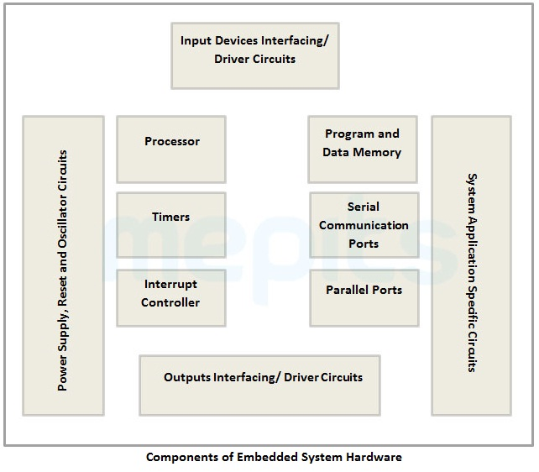
Embedded System
A microprocessor-based system designed to control a dedicated function, or a range of functions as opposed to general-purpose computers
A combination of computer hardware and software and additional parts, either mechanical or electronic
Often a component within a larger system
General-purpose computer interfaces to numerous embedded systems, such as keyboard and mouse
Common examples from everyday household appliances include a washing machine and a microwave oven

Slide 8
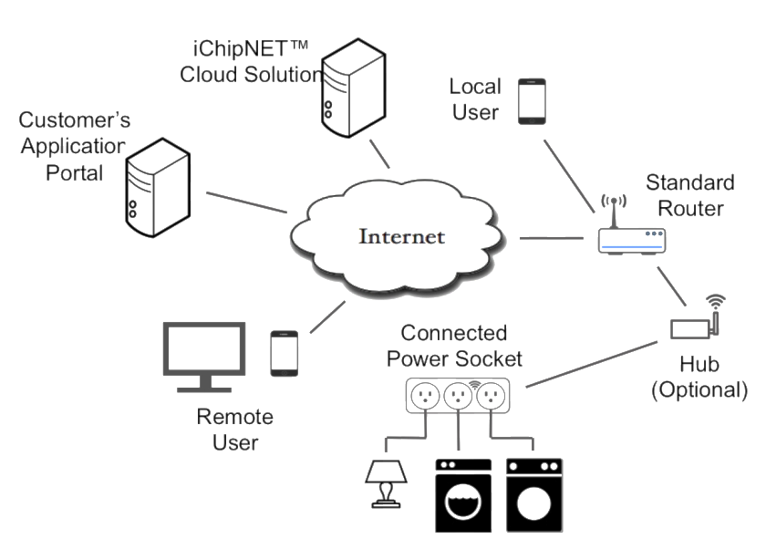
Internet of Things (IoT)
A network of physical devices, vehicles, home appliances, and other items embedded with electronics, software, sensors, actuators, and connectivity, enabling these objects to connect and exchange data.
Inter-networking of embedded devices, sensors, and computers
Can collect and distribute a large amount of data
Connected devices:
Only need to be connected to a network
Need to be individually addressable
Do not necessarily need to be connected to the public internet

Slide 9
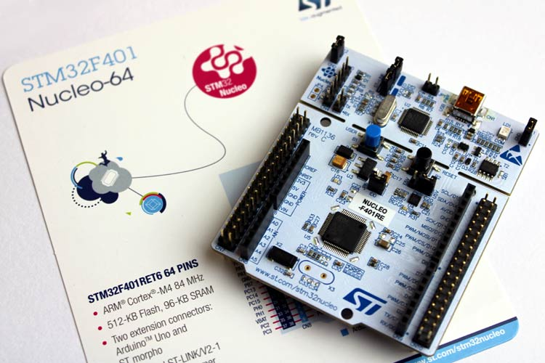
New Hardware Emerged for Embedded Systems
STMicroelectronics offered joint usage of microcontroller (Arm Cortex A) and microprocessor (Cortex M CPUs.
Development boards consisting of graphical processing units (GPU) allow parallel processing via high-level programming languages.
Recent advances in deep learning and neural networks also led to devices consisting of neural processing units (NPU or TPU) dedicated to neural network implementations.

Slide 10
New Hardware Emerged for Embedded Systems
At present, some of the popular microcontroller families in the market are:
ATMega family: ATMega328P, ATMega32
PIC-chips: PIC24, PIC33, etc.
ARM processors: Raspberry-Pi, TM4C chips, STM32 F401
In Bangladesh, ATMega based Arduino boards have gained wide popularity due to easy availability and low price
We are going to mostly focus on the ATMega328P chip during the midterm and then on the ARM processors in the final term.

Slide 11






Real-life Examples of embedded Systems
Automatic fare collection (AFC) ATM systems Factory robots
Medical devices Self-service kiosks Electric vehicle charging stations

Slide 12
Architecture of a Modern Microcontroller

Slide 13
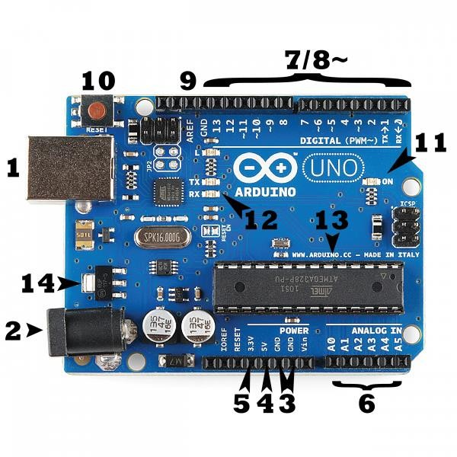
Basics Features of Arduino UNO
Consists of:
A programmable microcontroller (ATMega328) and
Integrated Development Environment or IDE
Uses a computer to write and upload code (written in the easier version of C++) to the microcontroller
Doesn’t need any additional programmer/burner
Operating voltage ranges from 1.8 V to 5.5 V
Digital pins: 14 (of which 6 provide PWM output)
DC Current per I/O pin: 20 mA

Slide 14
Arduino UNO Pin Configuration
1. Power (USB/Barrel Jack)
Every Arduino board needs a power source through a USB cable coming from your computer (1) or a wall power supply that is terminated in a barrel jack (2).
Pins (5V, 3.3V, GND, Analog, Digital, PWM, AREF):
GND (3): Short for ‘Ground’ and 5V (4) & 3.3V (5): used as supplies 5 volts of power, and the 3.3V pin supplies 3.3 volts of power.
Analog Pins (6): The area of pins under the ‘Analog In’ label (A0 through A5 on the UNO) are Analog Input pins. These pins can read the signal from an analog sensor (like a temperature sensor) and convert it into a digital value that we can read.

Slide 15
Arduino UNO Pin Configuration
Digital (7): Across from the analog pins are the digital pins (0 through 13 on the UNO).
PWM (8): You may have noticed the tilde (~) sign next to some of the digital pins (3, 5, 6, 9, 10, and 11 on the UNO).
These pins act as Pulse Width Modulation (PWM, think of these pins as being able to simulate analog output (like fading an LED in and out).
AREF (9): Analog reference input voltage pin to convert it into digital. It specifies the top value for the input range, and consequently each discrete step in the converted output. Most of the time you can leave this pin alone.

Slide 16
Arduino UNO Pin Configuration
Reset Button: Pushing it will temporarily connect the reset pin to the ground and restart any code that is loaded on the Arduino.
Power LED indicator (11): If this light doesn’t turn on, there’s a good chance something is wrong. Time to re-check your circuit.
TX RX LEDs (12): These LEDs will give us some nice visual indications whenever our Arduino is receiving or transmitting data (for example, when we are loading a new program onto the board).
Main IC (Integrated Circuit) (13): The main IC on the Arduino is the ATmega328 microcontroller of the ATMEL company., where we have to upload the code.
Voltage Regulator: The voltage regulator (14) is used to control the amount of voltage that is let into the Arduino board. But Arduino should not be powered by more than 20 V.

Slide 17
Example of a Modern Microcontroller: ATmega328
ATmega-328 is basically an Advanced Virtual RISC (AVR) microcontroller.
ATmega-328 has 32 KB internal built-in memory.
ATmega328 supports data up to eight (8) bits and has 28 Pins. AVR Microcontroller, manufactured by Microchip, follows RISC Architecture and has a flash-type program memory of 32 KB.
ATmega328 has 1 KB Electrically Erasable Programmable Read Only Memory (EEPROM). For an EEPROM, if the electric supply is removed from the microcontroller, it can store the data. After providing an electric supply it can provide previous results.
ATmega328 has 2 KB Static Random Access Memory (SRAM).
It has 8 pins for ADC operations, which all combine to form Port A (PA0-PA7).

Slide 18
Example of a Modern Microcontroller: ATmega328
It also has 3 built-in Timers, two of them are 8 Bit timers while the third one is a 16-Bit Timer.
Arduino UNO is based on Atmega328 Microcontroller. It is UNO’s heart.
It operates ranging from 3.3 V to 5.5 V but normally we use 5 V as a standard.
Its excellent features include cost efficiency, low power dissipation, programming lock for security purposes, real timer counter with a separate oscillator.
It is normally used in Embedded System applications.
Moreover, ATmega328 has several different features which make it the most popular device in today’s market. These features consist of advanced RISC architecture, good performance, 6 PWM pins, programmable Serial USART, programming lock for software security, throughput up to 20 MIPS, etc.

Slide 19
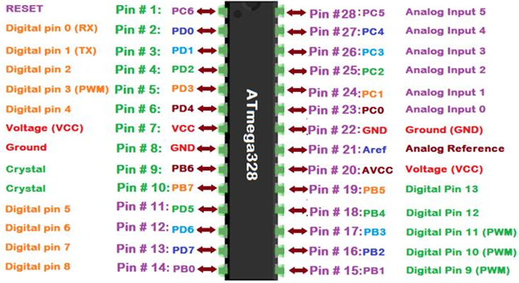
Arduino ATmega328 Pin Configuration

Slide 20
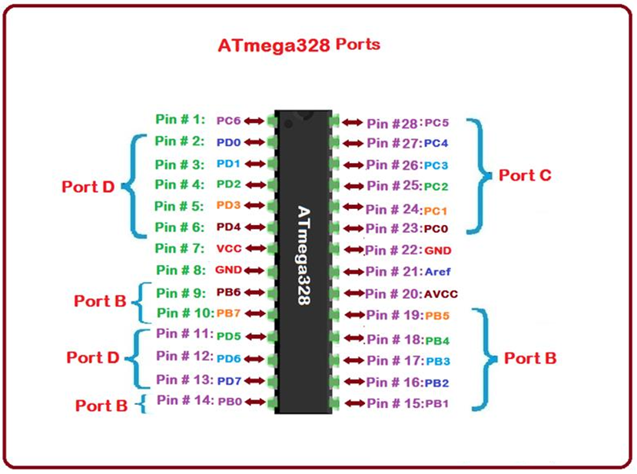
Arduino ATmega328 Port Configuration

Slide 21
Arduino ATmega328 Pin Description
Functions associated with the pins must be known in order to use the device appropriately:
VCC is a digital voltage supply.
AVCC is a supply voltage pin for analog to digital converter.
GND denotes Ground and it has a 0V.
ATmega-328 pins are divided into different ports which are given in detail below:
Port A consists of the pins from PA0 to PA7. These pins serve as an analog inputs to convert from analog to digital. Port A acts as an eight (8) bit bidirectional input/output port if ADC is not required.
Port B consists of the pins from PB0 to PB7. This port is an 8-bit bidirectional port having an internal pull-up resistor.
Port C consists of the pins from PC0 to PC7. The output buffers of port C have symmetrical drive characteristics with source capability as a well-high sink.
Port D consists of the pins from PD0 to PD7. It is also an 8-bit input/output port having an internal pull-up resistor.
AREF is an analog reference pin for analog to digital converter.

Slide 22
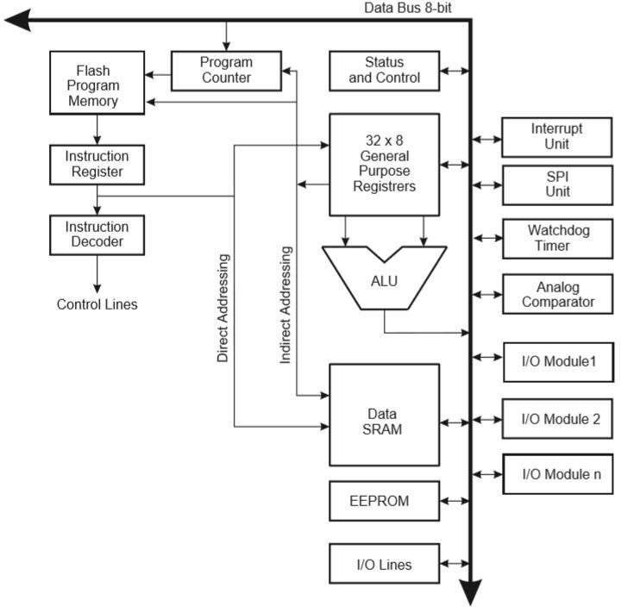
Internal Architecture of ATmega328
The ATmega328/P is a low-power CMOS 8-bit microcontroller based on the AVR enhanced RISC (reduced instruction set computer) architecture.
The clock is controlled by an external 16 MHz Crystal Oscillator.
The data is uploaded in serial via the port.
Instructions are sent to instruction register and it decodes the instructions on the same clock pulse.
In general purpose registers the registers are of 8-bit (used to store data for normal calculations and results) but there are 3 16-bit registers also (used to store data of timer counter).

Slide 23
Internal Architecture of ATmega328
EEPROM stores data permanently even if the power is cut out.
Interrupt Unit checks whether there is an interrupt for the execution of instruction to be executed in ISR (Interrupt Service Routine).
Serial Peripheral Interface (SPI) is used to send data between microcontroller and small peripherals such as Camera, Display, SD cards, etc. It uses separate clock and data lines, along with a select line to choose the device you wish to talk to.
Watchdog timer is used to detect and recover from MCU malfunctioning.

Slide 24
Internal Architecture of ATmega328
Analog comparator compares the input values on the positive and negative pin, when the value of positive pin is higher the output is set.
Status and control is used to control the flow of execution of commands by checking other blocks inside the CPU at regular intervals.
ALU (Arithmetic and Logical Unit): The high performance AVR ALU operates in direct connection with the all 32 general purpose registers. Within a single clock cycle, arithmetic operations b/w general purpose registers are executed. The ALU operations are divided into 3 main categories– arithmetic, logical and bit-function.

Slide 25
Internal Architecture of ATmega328
I/O pins The digital inputs and outputs (digital I/O) on the Arduino are what allow you to connect the Arduino sensors, actuators, and other ICs. Learning how to use them will allow you to use the Arduino to do some really useful things, such as reading switch inputs, lighting indicators, and controlling relay outputs.

Slide 26
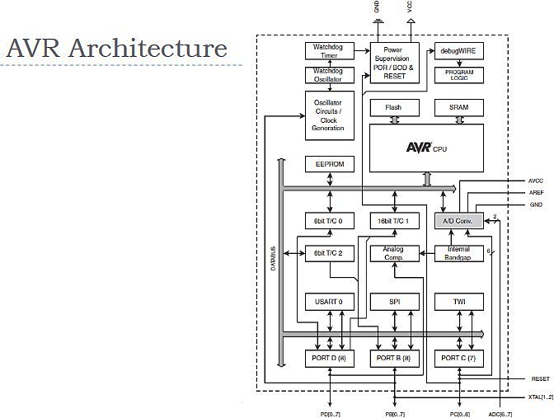
Internal Architecture of AVR
6 different oscillators to serve as clock sources
5 different clock outputs from the AVR clock control Unit
CPU clock routed to part of the system concerned with the operation of AVR core
I/O clock used by most I/O modules
Flash clock controls operation of the flash interface
Asynchronous timer clock allows asynchronous timer/counter to be clocked directly by external clock
ADC Clock is dedicated to the ADC module

Slide 27
Internal Architecture of AVR
CPU is the Central Processing Unit
The main function of the CPU core is to ensure correct program execution.
The CPU must therefore be able to access memories, perform calculations, control peripherals, and handle interrupts.
In order to maximize performance and parallelism, the AVR uses a Harvard architecture – with separate memories and buses for program and data.

Slide 28
Instruction Fetch and Decode
Separate memories and busses for program and data (Harvard Architecture)
Instructions in program memory are executed with single-level pipelining
The next instruction is pre-fetched from program memory while previous instruction is being executed
Instructions are executed every clock cycle
Program counter points towards the next instruction to be executed

Slide 29
ALU Instructions
ALU supports both arithmetic and logic operations between:
Registers
A constant and a register
Single register operations can also be executed
Status register updated after arithmetic operations to reflect information about the operation
In typical ALU operations, in a single clock cycle:
Operation is executed
Result is stored back in the register

Slide 30
I/O and Special Functions
When used as general digital I/O ports, all AVR ports have true read-modify-write functionality.
General digital I/O pins are:
Bi-directional
Optional internal pull-ups
When configured as an input pin, pull up resistor is activated
When configured as an output pin, pull up resistor is turned off
Most digital I/O pins have alternate functions

Slide 31
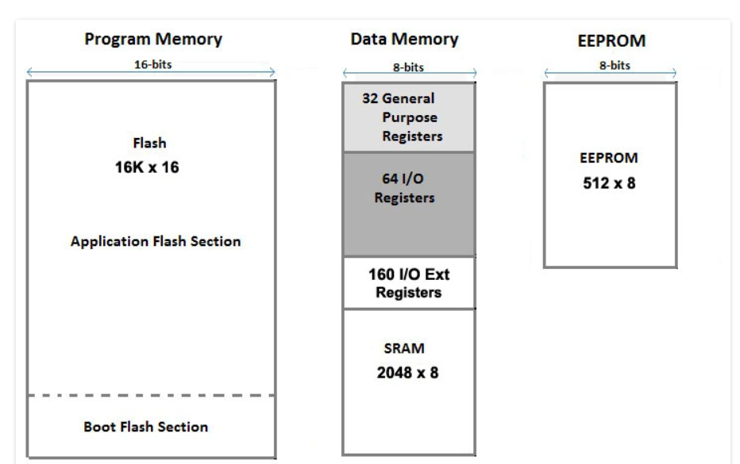
ATmega328 Memory
ATmega 328 has three types of memories:
Flash Memory (Program Memory) has 32 KB capacity. It has an address of 15 bits. It is a non-volatile memory. It is used for the permanent saving program (CODE) being executed. The AVR executes programs stored in program memory only.
SRAM stands for Static Random Access Memory. It is also called Data Memory. It has a 2 KB capacity. It is a volatile memory i.e., data will be removed after removing the power supply.
EEPROM stands for Electrically Erasable Programmable Read Only Memory. It has a 1 KB capacity. It has long-term data.

Slide 32
ATmega328 General Purpose Registers
ATmega-328 has thirty-two (32) General Purpose Registers (GPR).
All these registers are part of Static Random Access Memory (SRAM).
These GPRs are 8-bit in size.
Most instructions operating on the Register file:
Have direct access to all registers
Most are single-clock cycle execution

Slide 33
References:
The Intel microprocessors By Barry B. Brey
Microprocessors and Microcomputer-based System Design By Mohamed Rafiquzzaman
Implementing a One Address CPU in Logisim By Charles W. Kann
Security in Embedded Systems By J. Rosenberg
External Search By Stefan Edelkamp and Stefan Schrödl
Embedded Systems Design By Steve Heath
Programming Embedded Systems with C and GNU Development Tools By Michael Barr and Anthony Massa
The Rise of “Internet of Things”: Review and Open Research Issues Related to Detection and Prevention of IoT-Based Security Attacks, By Muhammad Shafiq, ,Zhaoquan Gu, Omar Cheikhrouhou, Wajdi Alhakami, and Habib Hamam, Wireless Communications and Mobile Computing, 2022
Internet of Things and Big Data Analytics Toward Next-Generation Intelligence By Nilanjan Dey, Aboul Ella Hassanien, Chintan Bhatt, Amira S. Ashour, Suresh Chandra Satapathy
Family Datasheet: 8-bit AVR Microcontrollers
Arduino Uni R3 Datasheet

Slide 34
Thanks for attending….
?

